Slide 1


Project BuzzScale IPO & Data Optimization

Slide 2


Today's agenda
Project recap
Problem
The Analytics team
Process
Insights
Summary

Slide 3

Social Buzz, a social media and content creation company headquartered in San Francisco, has rapidly grown to over 500 million active monthly users. The company is seeking external expertise for scaling its data infrastructure, preparing for an IPO, and improving its big data management practices.
Accenture has been engaged in a 3-month project which includes:
1. Audit their big data processes,
2. Provide IPO recommendations,
3. Analyze content categories for user popularity.
Project Recap

Slide 4

Problem Statement
Social Buzz is facing three primary challenges:
IPO Preparation: They aim to complete an IPO by next year but lack internal expertise in managing the financial and operational complexities associated with this.
Scalability Issues: With only 250 employees, of which 200 are technical staff, they lack the resources to efficiently manage the scale of their operations. Over 100,000 pieces of unstructured content are created daily, demanding advanced data handling solutions.
Big Data Best Practices: Social Buzz has amassed a large volume of data, but they need guidance on industry-leading best practices for managing and leveraging their data effectively to ensure sustainable growth and operational efficiency.

Slide 5



Andrew Fleming
(Chief Technical Architect)
The Analytics team
Marcus Rompton
(Senior Principle)
Manas Nayan Mukherjee
(Associate Data Analyst)

Slide 6
Workflow Segregation
1
Data Understanding
Data Cleaning & Feature Engineering
2
3
Data Modelling
4
Data Analysis
5
Conclusion

Slide 7
Data Understanding
We utilized the SocialBuzz BigData Scaling Audit dataset for our analysis and model building. This dataset is composed of 7 distinct subsets, each containing different columns and values. From these, we identified the following datasets as most relevant for our analysis:
Reaction
Content
Reaction Types
The selection of these datasets was driven by the client’s request to analyze content categories and highlight the top 5 categories with the largest popularity. Below is a breakdown of each selected dataset:
Content – 1,000 observations (rows) with 5 features:
Content ID, User ID, Type, Category, URL
Reactions – 25,553 observations (rows) with 4 features:
Content ID, User ID, Type, Datetime
Reaction Types – 16 observations (rows) with 3 features:
Type, Sentiment, Score

Slide 8
Data Understanding
Let’s understand each feature
Data Description:
Content ID: Unique identifier for each piece of uploaded content.
User ID: Unique identifier for users.
Type: The type of content (e.g., text, image, video).
Category: The category the content belongs to (e.g., entertainment, tech).
URL: Link to the location where the content is stored.
Datetime: The date and time of user reactions.
Score: A calculated value that measures the popularity of each reaction type, where higher scores indicate greater popularity.

Slide 9
Data Cleaning
In the Data Cleaning phase, we focused on refining the dataset to ensure the analysis was accurate and meaningful. The process involved:
Removing rows with missing values
Changing data types
Removing irrelevant columns

Slide 10
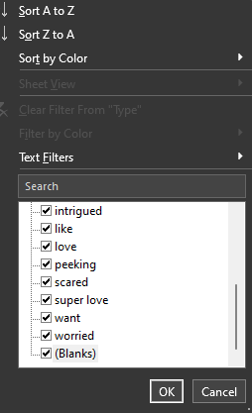
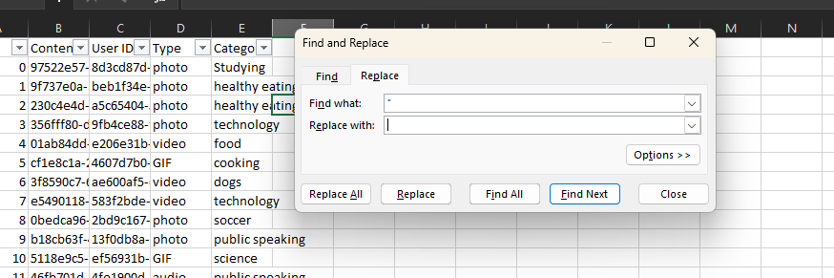
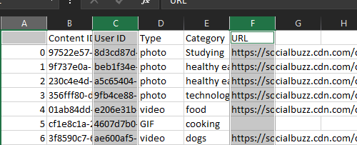
Data Cleaning
Here’s how we do it:
Removing rows with missing values: We deleted rows in the reactions dataset that contained blank or missing data to prevent inaccuracies in the analysis.
Changing data types: We ensured that all columns had appropriate data types, making it easier to analyze and visualize the data.
Removing irrelevant columns: Columns like 'User ID' and 'URL' were removed as they didn’t provide any relevant information for this task.

Slide 11
Data Cleaning
Key actions taken:
We found duplicate entries in the 'Category' column of the content dataset, some with quotation marks and some without. These were corrected to prevent duplication.
We deleted rows with missing or blank values in the reactions dataset, improving the overall quality of the data.
The 'User ID' column was removed from both the content and reactions datasets as it wasn’t required for the analysis.
After cleaning, the reactions dataset contained 24,573 rows ready for further analysis.

Slide 12


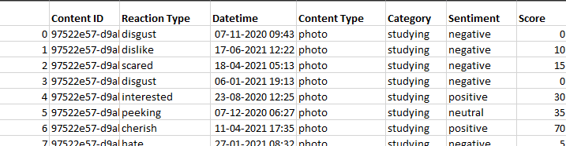
Feature Engineering
In addition, we performed some feature engineering to improve clarity:
We renamed the 'Type' column in the content dataset to 'Content Type’.
In the reactions dataset, the 'Type' column was renamed to 'Reaction Type' for consistency and ease of use.
This cleaned and structured data now serves as the foundation for further analysis and insights.

Slide 13
Data Modelling
Data modeling is an essential step in the development of databases and data-driven applications, ensuring that data can be effectively utilized to meet business objectives.
We performed two major tasks under data modeling:
Created a Final Dataset
Figured Out the Top 5 Performing Categories

Slide 14
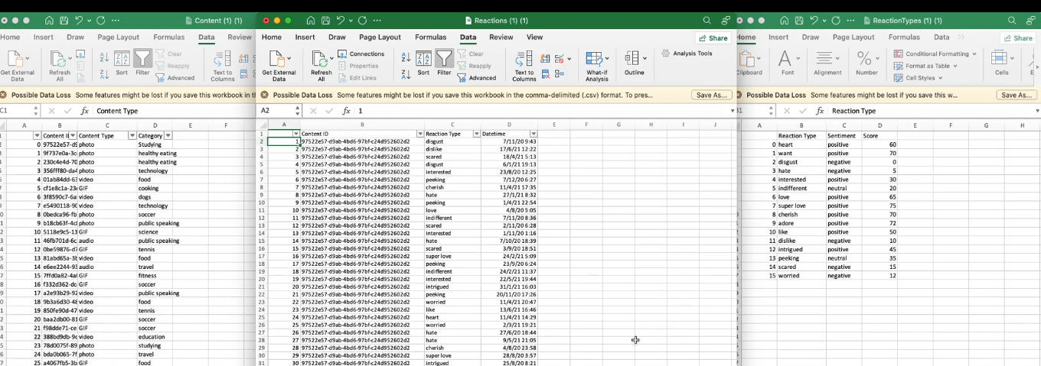
Data Modelling
We created the final dataset by merging three tables: Reactions, Content, and Reaction Types. We used the Reactions dataset as the base and joined relevant columns from the Content dataset (specifically, 'content type' and 'category') and from the Reaction Types dataset (specifically, 'sentiment' and 'score'). The joins were performed using 'content_id' and 'reaction_type_id' as keys.

Slide 15
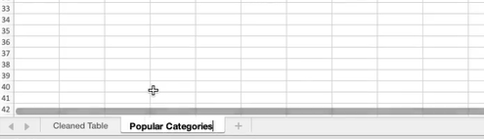
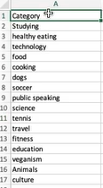
Data Modelling
In the cleaned dataset, we created a new tab named 'Popular Categories’.
We cleaned the list of categories and identified 16 unique categories. To calculate the popularity of each category, we computed an aggregate score by summing the individual scores of each category.

Slide 16
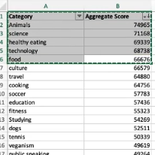
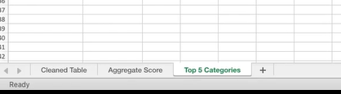
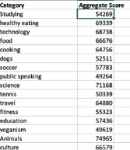
Data Modelling
The data was then sorted in descending order to identify the top 5 popular categories.
A new tab, 'Top Categories', was created to show the top 5 categories along with their aggregate scores.
Finally, we renamed the 'Popular Categories' tab to 'Aggregate Score'.

Slide 17

Data Modelling
So now in our final dataset we have three tabs which are 'Cleaned table', 'Aggregate score' and 'Top 5 Categories'

Slide 18
Data Analysis
Data analysis is the systematic process of inspecting, transforming, and modeling data to uncover useful information, draw conclusions, and support decision-making. Through effective data analysis, we can reveal valuable insights that drive strategic actions.
These insights not only enhance our understanding of the data but also guide future strategies in content management and audience engagement.

Slide 19
Data Analysis
Unique Categories: There are 16 unique categories within the dataset, highlighting the diversity of content.
Most Popular Category: The category with the highest engagement received a total of 1,897 reactions, indicating strong audience interest.
Peak Activity Month: January emerged as the month with the most posts, suggesting it was a significant period for content creation and interaction.
16
1897
January

Slide 20
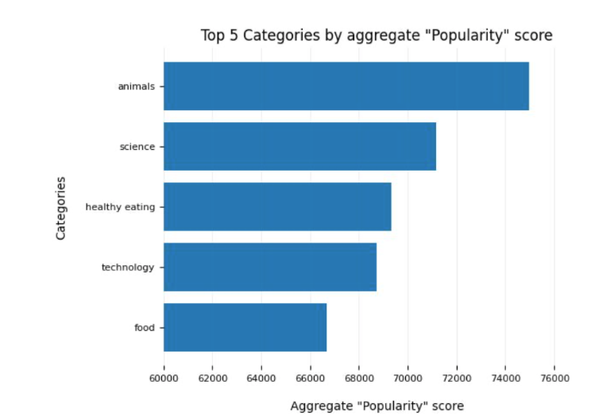
Data Analysis
Here we have visualized the top 5 categories based on their aggregate score

Slide 21
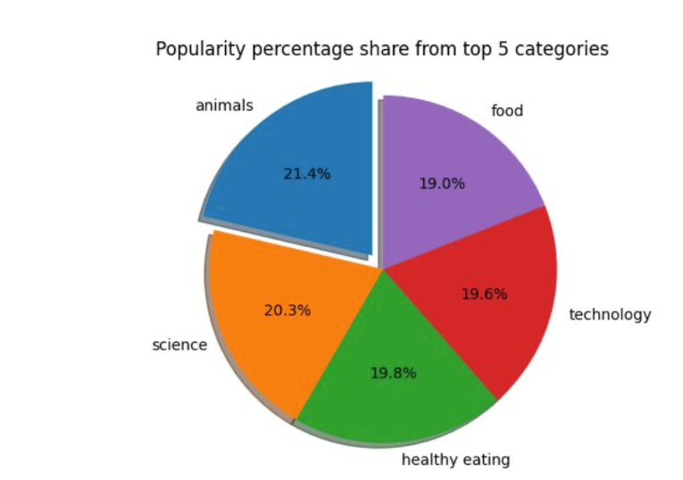
Data Analysis
Here we have visualized the top 5 categories based on their popularity

Slide 22


Conclusion
Analysis
Animals and science are the two most popular categories, indicating that Social Buzz’s audience is most engaged with real-life and factual content. These categories consistently receive the highest number of reactions, showing a strong preference for this type of content.
Insight
Food-related themes appear multiple times in the top 5 categories, with "Healthy Eating" being the most prominent. This suggests that your audience has a significant interest in food and wellness. Social Buzz could create targeted campaigns around healthy eating, potentially collaborating with food or wellness brands to increase engagement and attract new users.
Next Steps
To enhance content performance, we recommend implementing automated systems for continuous, real-time analysis. This will enable faster, data-driven decisions. We can help set up dashboards for real-time insights and optimize your content strategy to boost engagement across all categories.
By leveraging these insights, Social Buzz can improve content relevance, engage users more effectively, and build valuable partnerships with brands that align with audience interests.

Slide 23
Thank you!
ANY QUESTIONS?

